Slide 1
ROADIES

Slide 2
Visual Spectacles
Team Members
Sai Kiran Reddy
Harini Reddy

Slide 3
INTRODUCTION
This Project is useful To Explore Mahabubnagar.It Includes All The Tourist Locations which are the speciality of the city.It also provides all locations,reviews along with images which are useful for the tourist.It has BASIC info such as restraunts,shops and bus stops along with EMERGECY info such as hospitals.
The usage if also simple even to novice users as long as they are familiar with basic English.

Slide 4
Technical info
The Languages used in the project are HTML and CSS.
The code was executed in visual studio code.

Slide 5
Features
all types of users can use including novice users.
Includes places of all price ranges making it available for people of all financial capacities.
Easier to search the places for any additional info as visual search option is provided for every image.
Linked to google maps making the location details trust worthy and accurate.

Slide 6
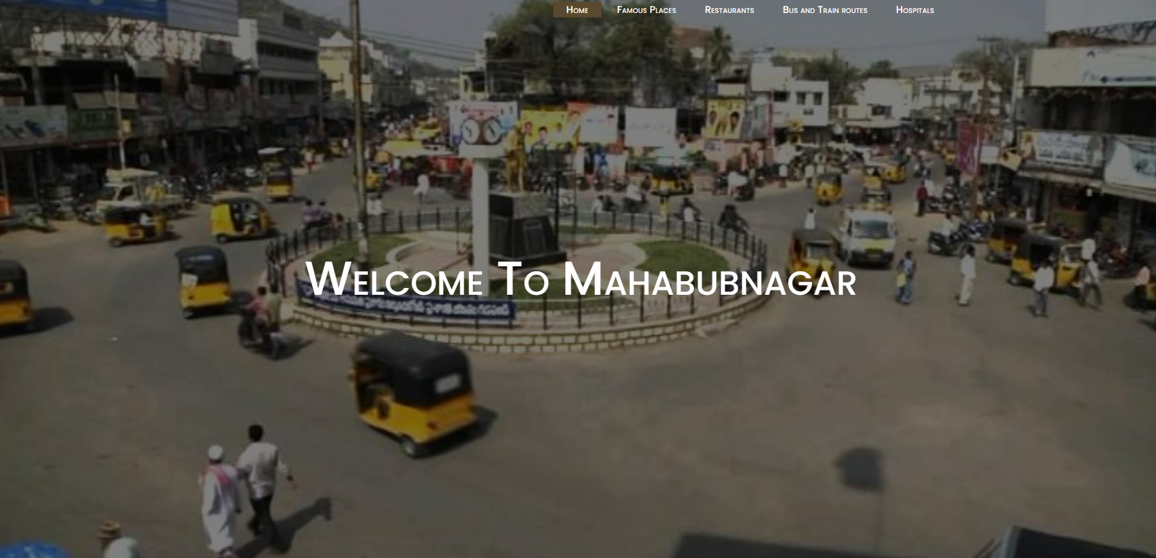
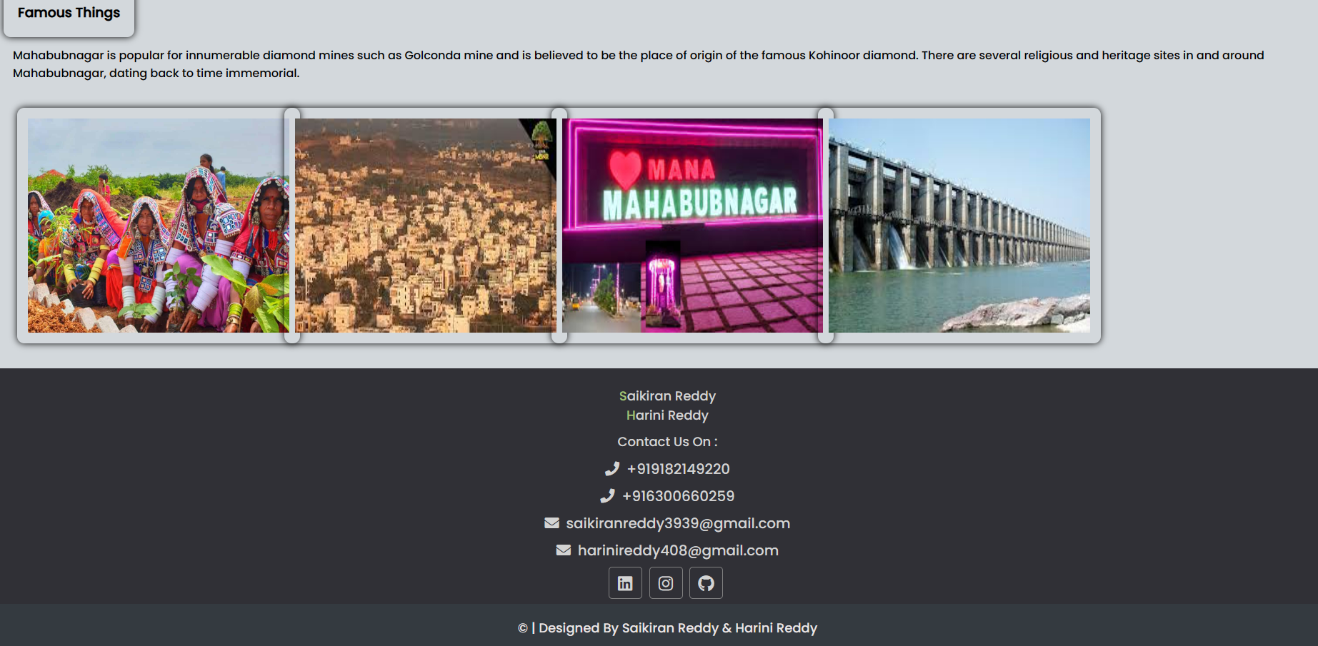
User manual

Slide 7
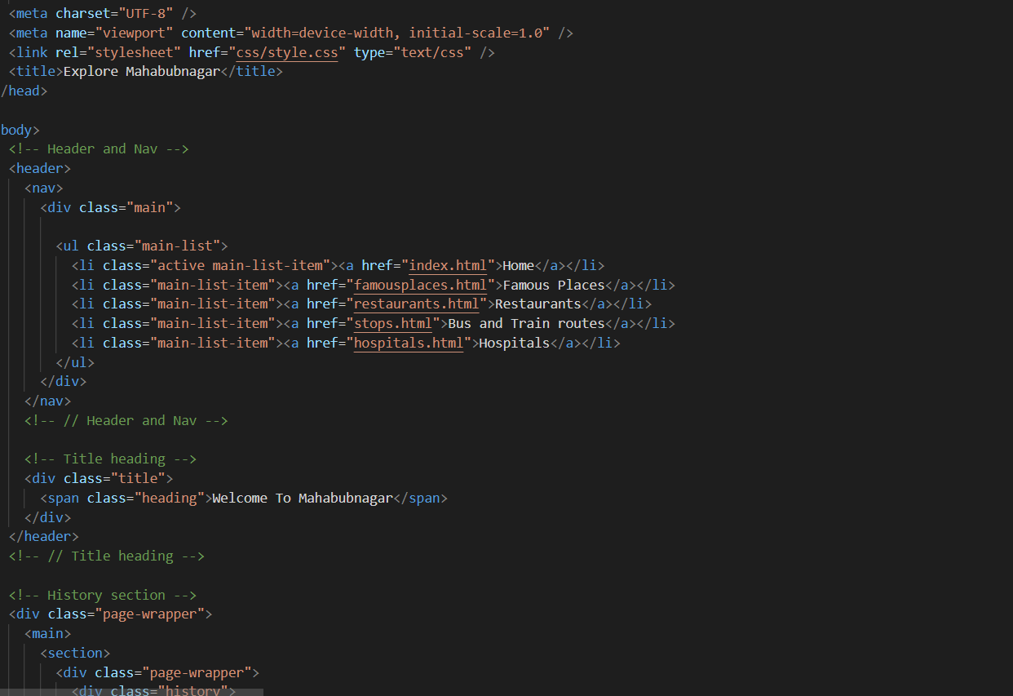
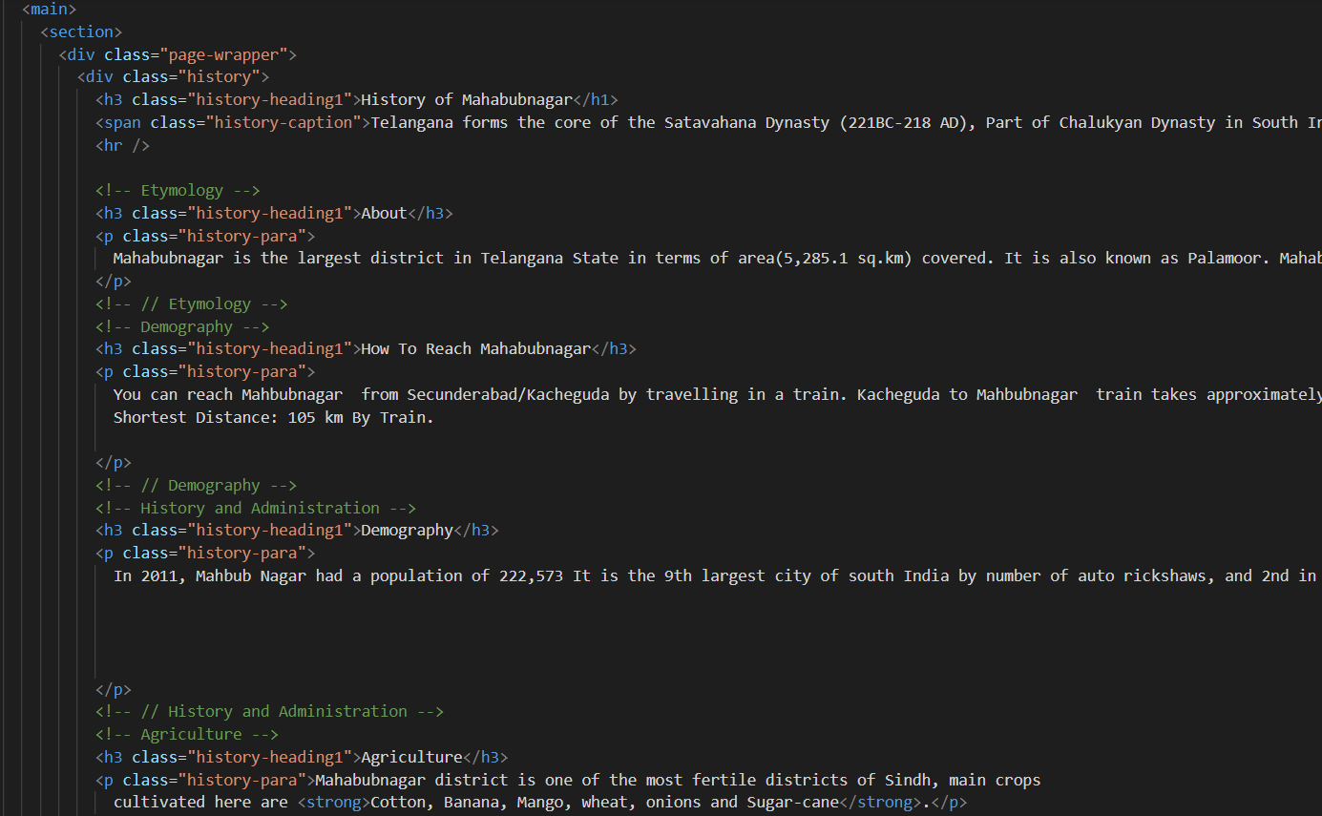
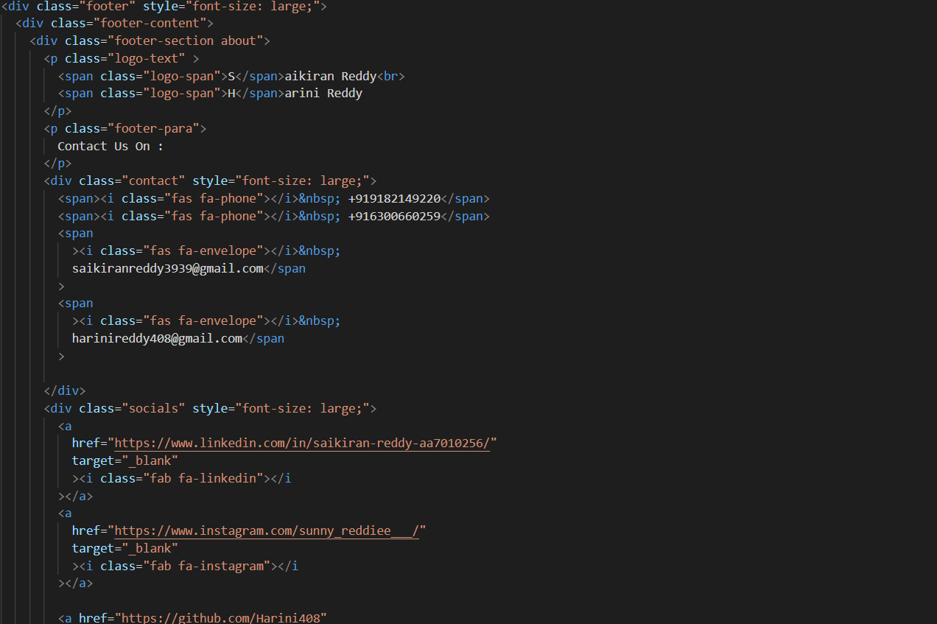
CODE DOCUMENTATION

Slide 8
FUTURE WORK
To expand the teritary by adding in many cities.
To develop into an app.
To improve it such user authentication is included.
To add info regarding any trustworthy tour guides

Slide 9
Conclusion
This concludes our project which is useful for people who are new to the city and have no one to guide them to its special locations and also the basic details about the place.This can make them feel safe and self dependent.

Slide 10
Thank You

